Slide 1
FIT CLUB
SHREEJA R

Slide 2

ABOUT PROJECT
Fit club is a Fitness club application.
It allows user to view the club workout process.
Shows the user which are the classes available in the club.
It describes how the classes are taken.
Gives details about the trainers.
Shows the latest news.
The application also contains the registration form.
The form has the contact details of the team

Slide 3
Features implemented
Following features have been implemented in this app development.
JSON-Server-Auth
Deletion from json
nginx pipes Form handling Lazy loading of modules Routing, Child routing and params HTTPClient and Observables Angular Material Controls Service calls with secure end points (Token based auth)

Slide 4
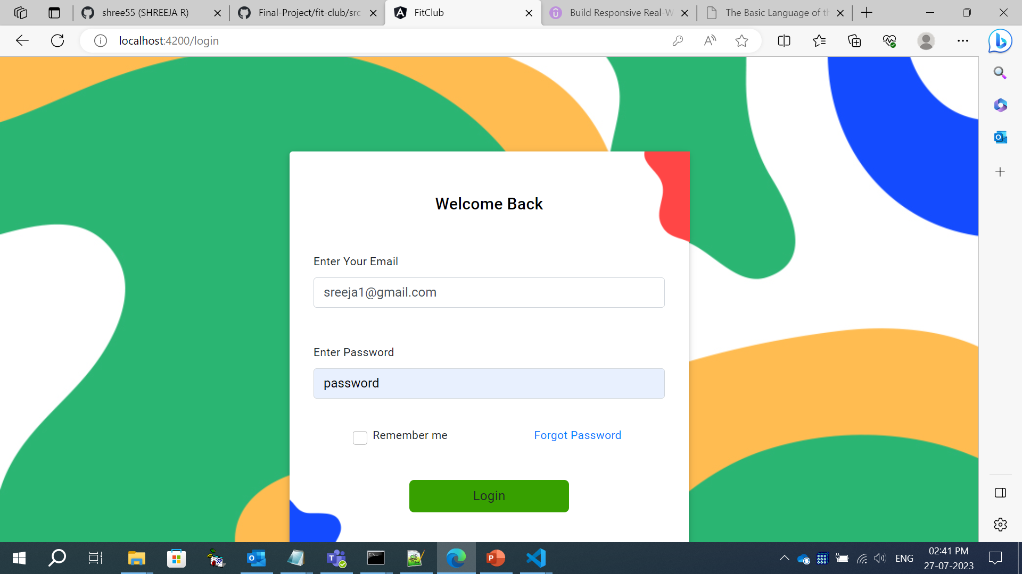
LOGIN PAGE

Slide 5
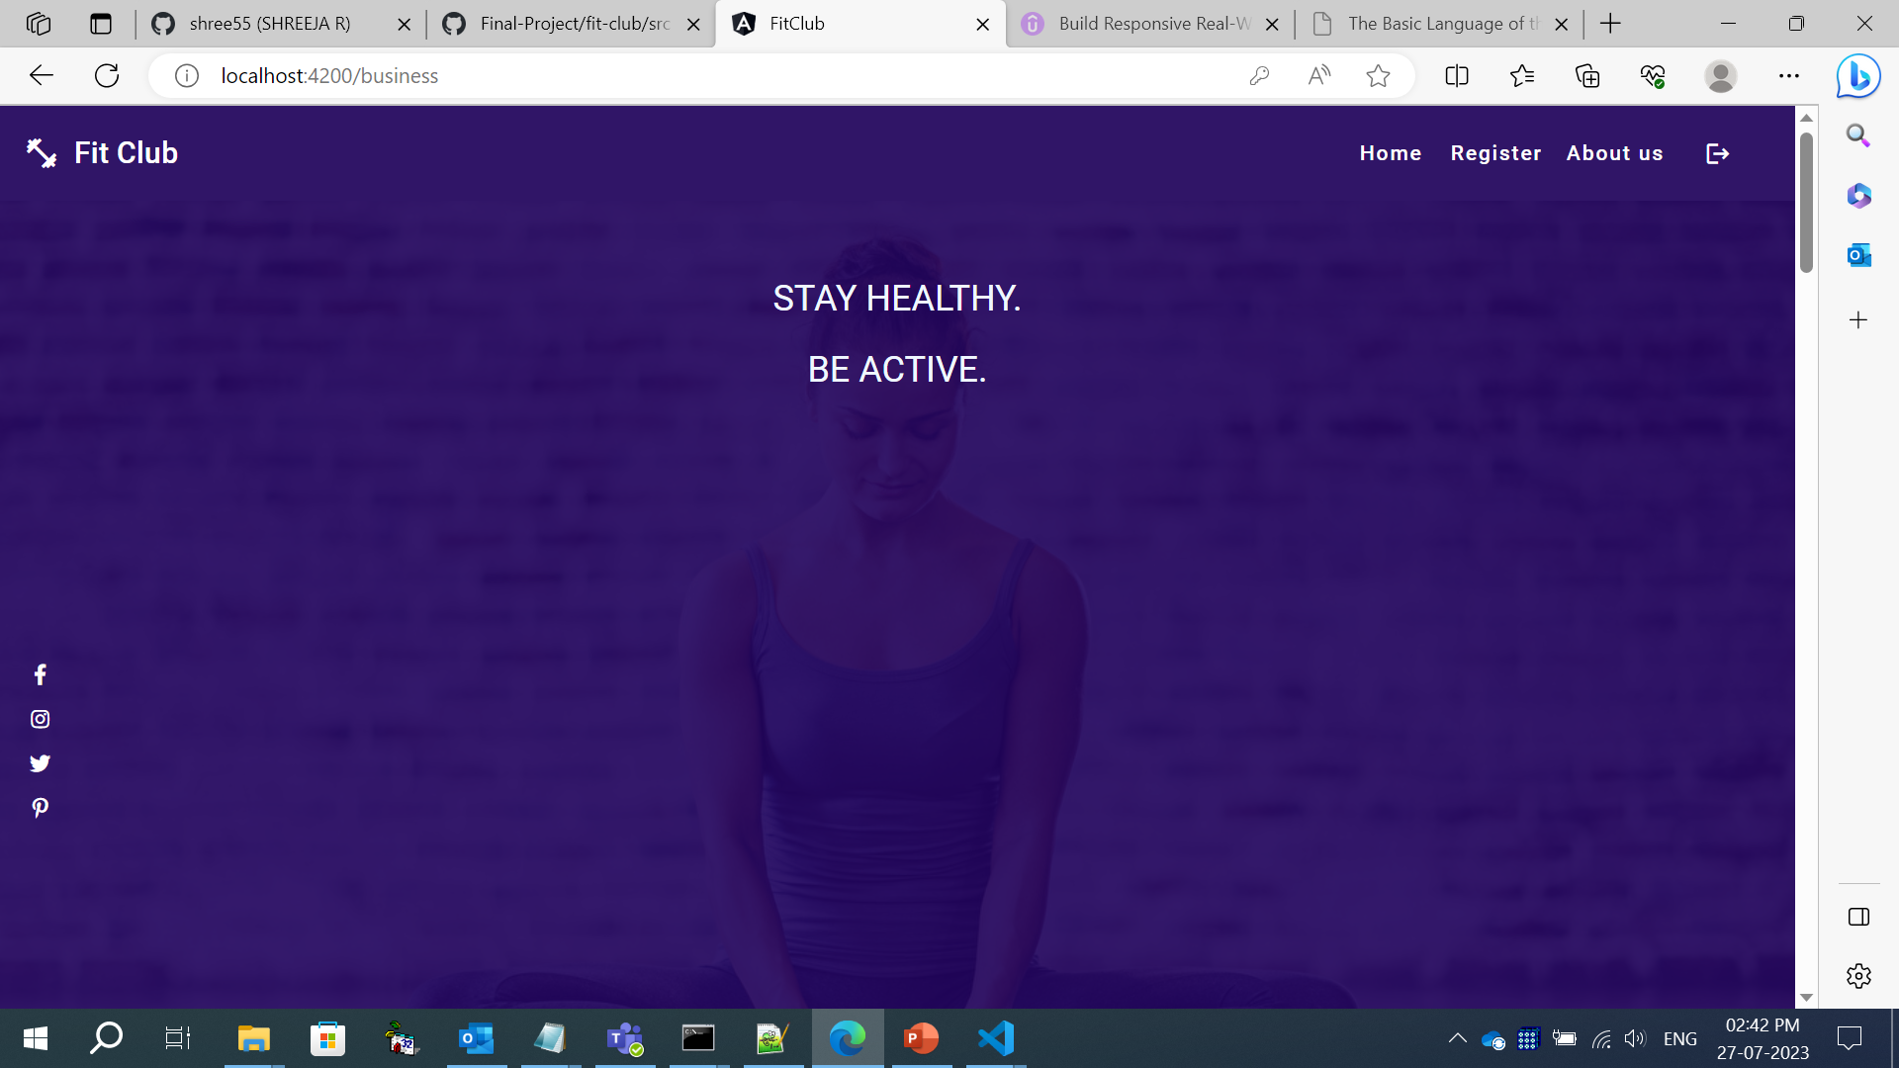
HOME PAGE

Slide 6
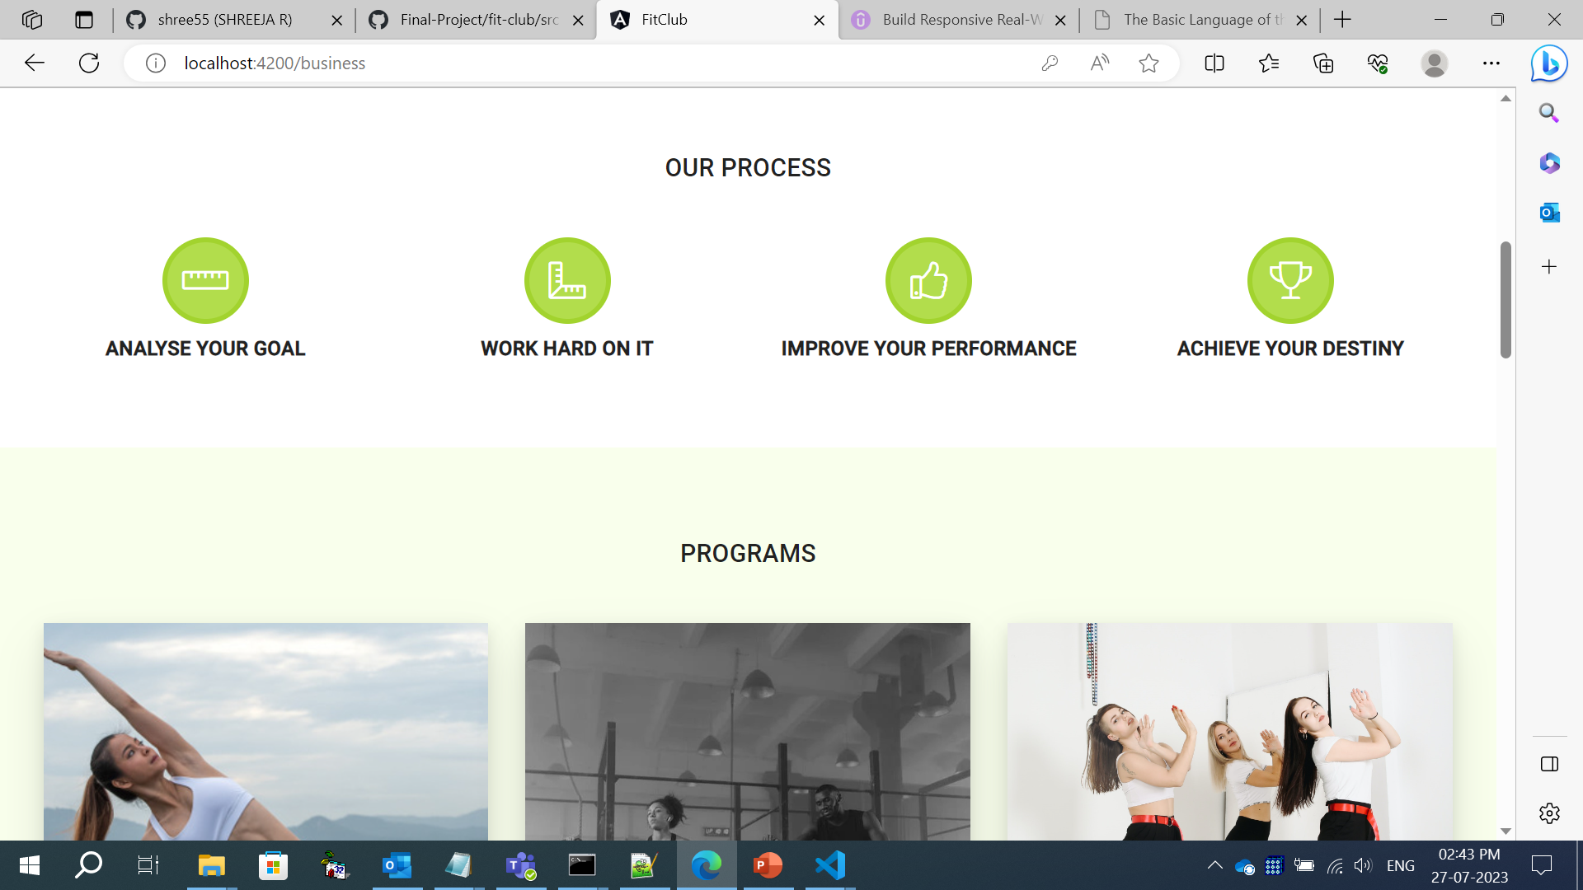
User Home Page

Slide 7
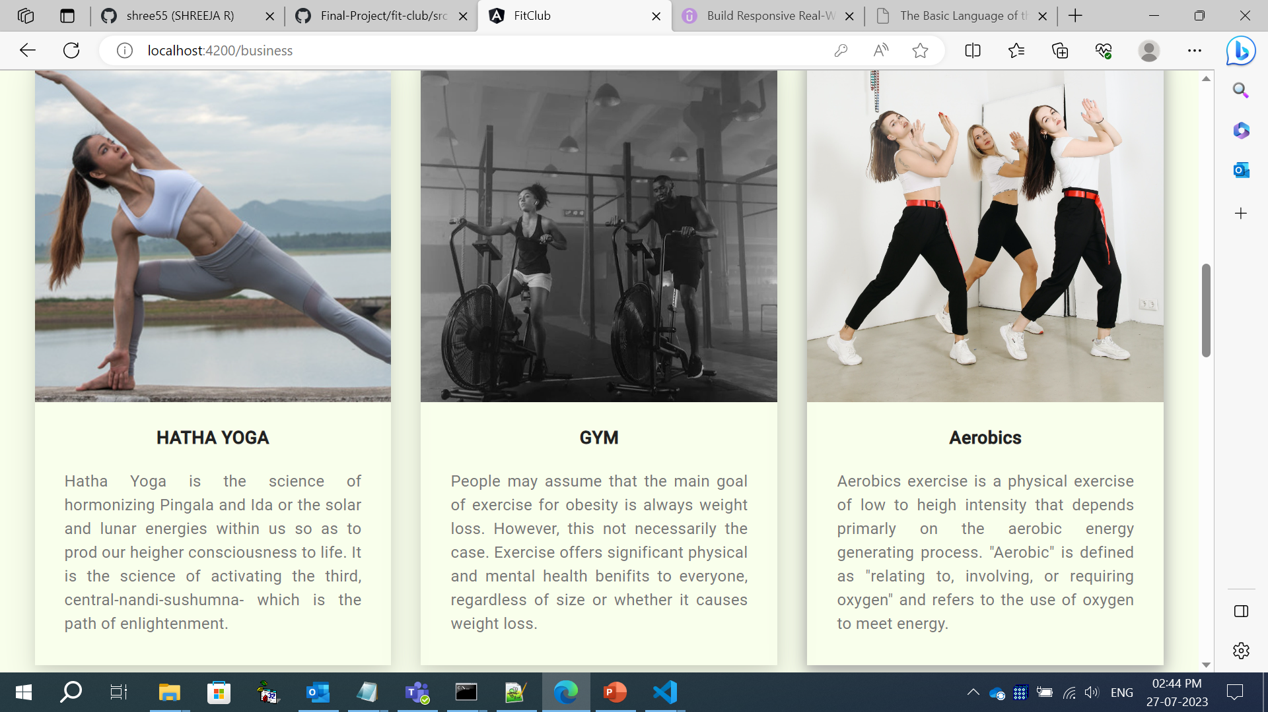
HOME PAGE (PROGRAMS)

Slide 8
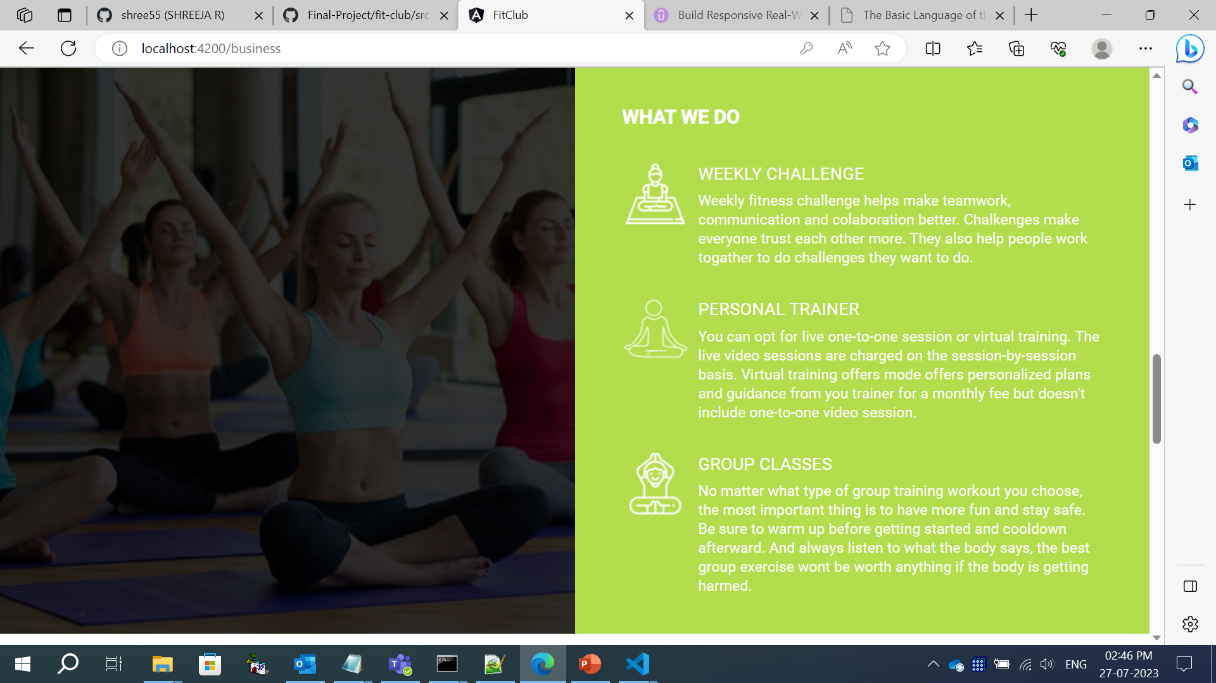
USER HOME PAGE

Slide 9
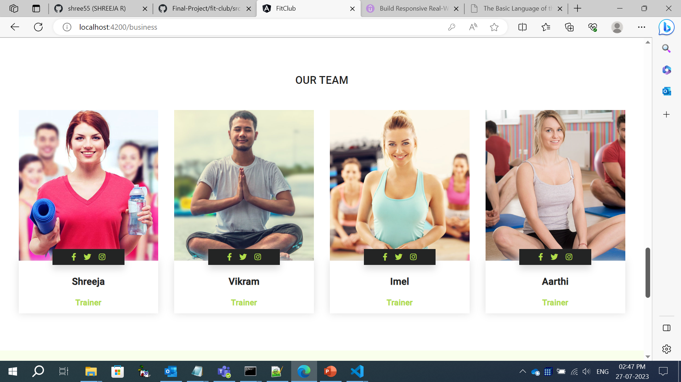
USER HOME PAGE (ABOUT TRAINERS)

Slide 10
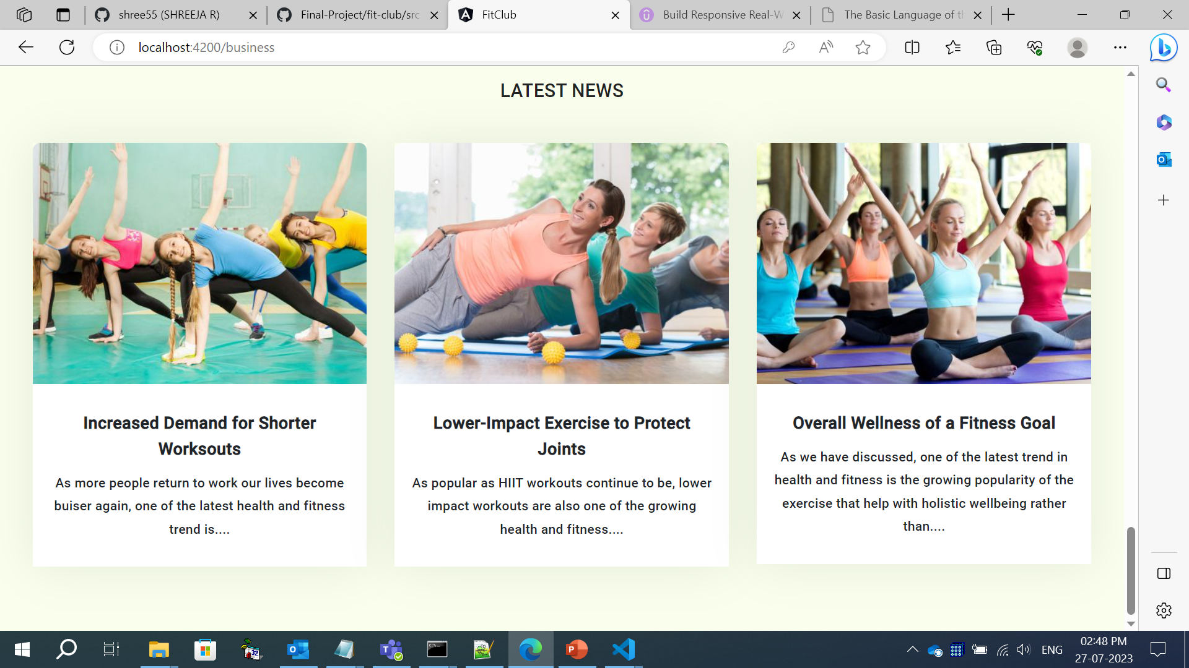
HOME PAGE (LATEST NEWS)

Slide 11
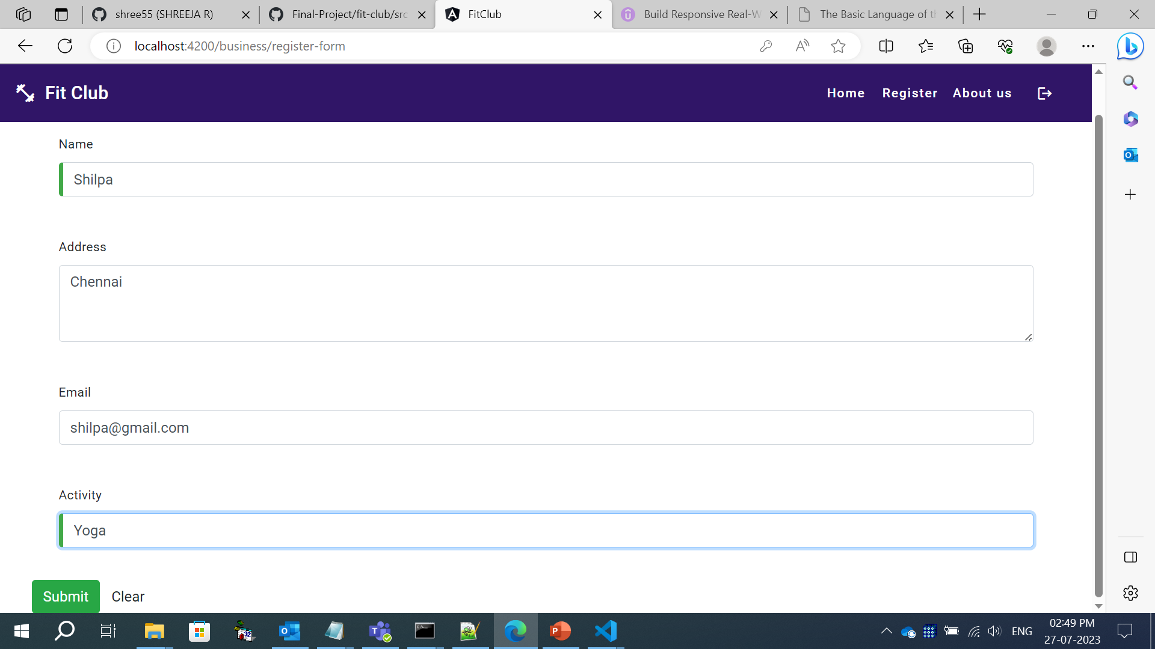
Registration Page

Slide 12
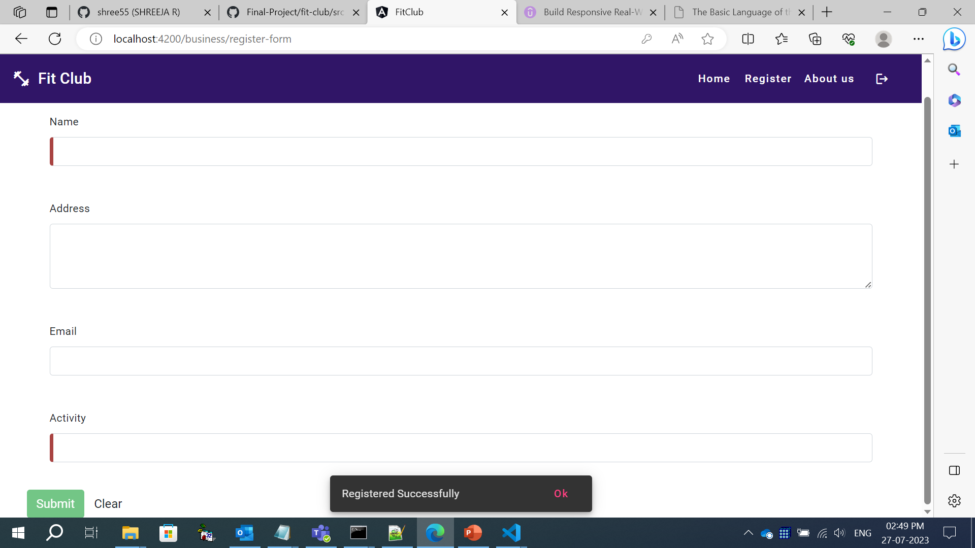
Registration Page

Slide 13

Admin can login in other mail id and check the registered details

Slide 14
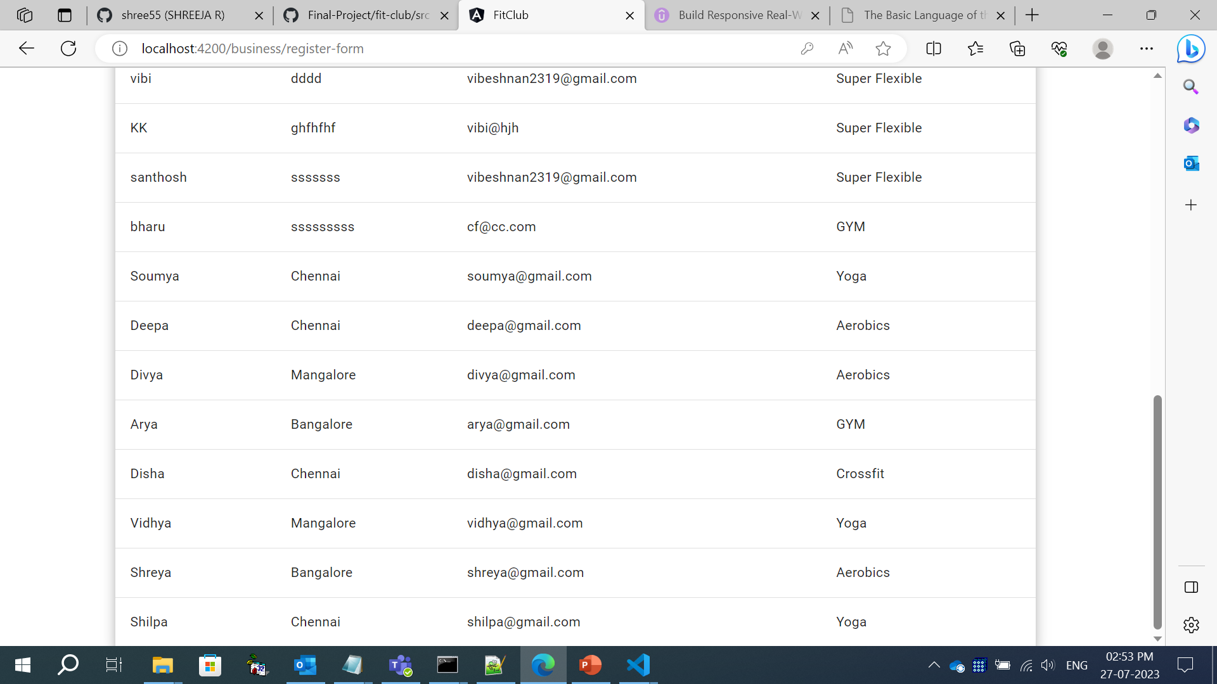
Registration Form list

Slide 15
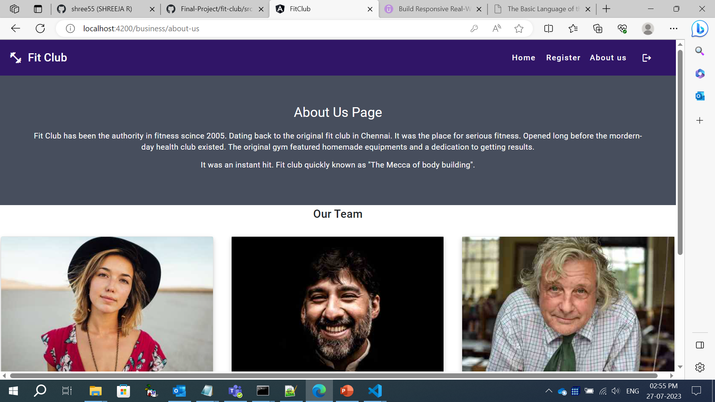
ABOUT US PAGE I

Slide 16
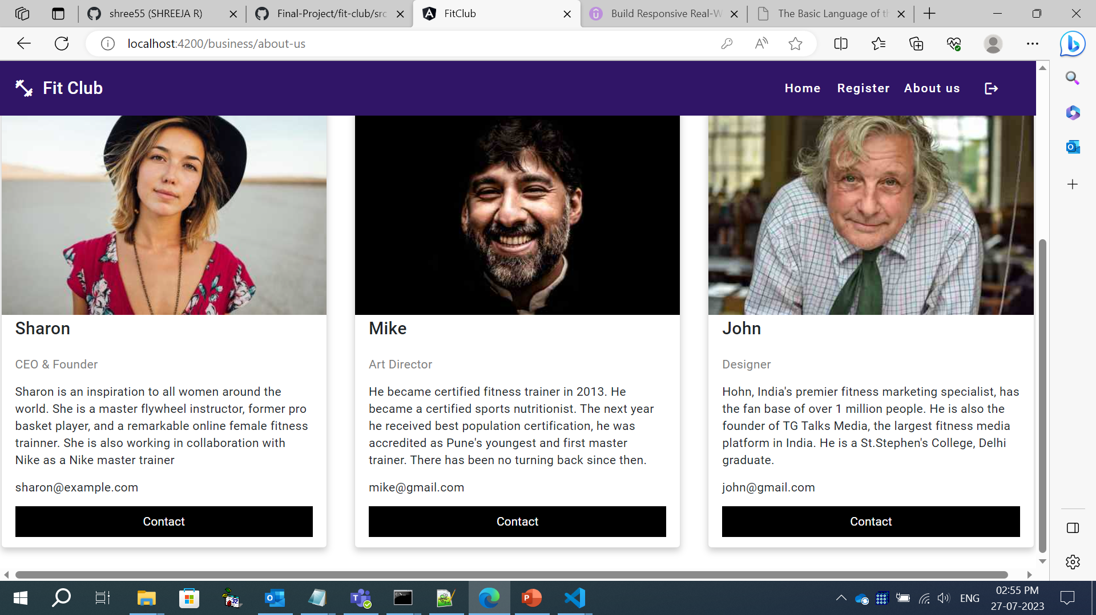
ABOUT US PAGE II

Slide 17
THANK YOU

